Slide 1

EditEdit MasterMaster texttext stylesstyles
Practical Lecture 2: Concepts & Basics of C++ Programming

Slide 2

Quick Recap
Let’s take a quick recap of previous lecture
cin, cout
Basic Data Types
Loops in C++

Slide 3
Today’s Agenda
Derived data types ( Array, structure, union, enum, pointer)
Array
Structure
Union
Enum
Pointer(will be covered later in detail)

Slide 4
C++
Let’s Get Started-

Slide 5
Installation
On Visual Studio code:-https://code.visualstudio.com/docs/languages/cpp
One Code Blocks:-https://www3.ntu.edu.sg/home/ehchua/programming/howto/CodeBlocks_HowTo.html

Slide 6
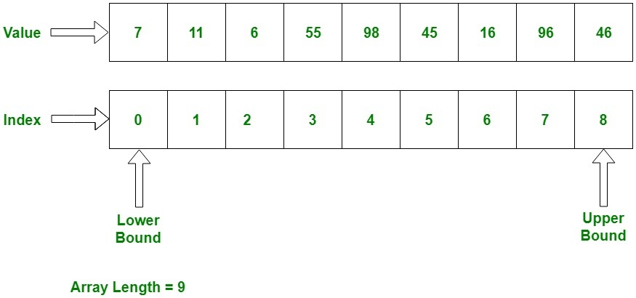
Array
Why arrays?
Definition: An array is a collection of similar items stored in contiguous memory locations.

Slide 7
Practice Question's
Write a program to find the size of all the data types.
Write a program to check whether a number is prime or not.
Write a program to print the greatest among the three numbers entered by the user.
Write a program to check whether the year is leap or not.

Slide 8
Declaring array
Method 1:-int arr[5];
arr[0] = 10;
arr[1] = 20;
arr[2] = 30;
arr[3] = 40;
arr[4] = 50;
Method 2:-
int arr[] = {10, 20, 30, 40, 50};
Method 3:-
int arr[5] = {10, 20, 30, 40, 50};

Slide 9
Accessing Array
#include <iostream>
using namespace std;
int main(){
int arr[] = {11, 22, 33, 44, 55};
cout<<arr[0]<<endl;
cout<<arr[1]<<endl;
cout<<arr[2]<<endl;
cout<<arr[3]<<endl;
cout<<arr[4]<<endl;
return 0;
}

Slide 10
Practice Questions
Write a program to print the sum and product of all the number in the given array.
Write a program to find the greatest number in the array.
Write a program to check whether user entered string is palindrome or not.
Write a program to convert decimal number into hexadecimal number (Hint: use switch case and array)
Write a program to find out second maximum and second minimum number from an array.

Slide 11
structure
A structure is a group of dissimilar data elements grouped together under one name.
These data elements, known as members, can have different types and different lengths.

Slide 12
Practice Questions
Write a program to define a struct student with data members as following
int rollno;
char name[50];
char course[10];
float marks;
Read the data from user and display the entered data.
Homwork: Write a program to define structure of an employee to record and display employee no, name, dept,salary.

Slide 13
union
Unions allow one portion of memory to be accessed as different data types.
Its declaration and use is similar to the one of structures, but its functionality is totally different
The size of this type is the one of the largest member element.
Modification of one of the members will affect the value of all of them
It is not possible to store different values in them in a way that each is independent of the others.

Slide 14
enum
An enumeration is a user-defined data type that consists of integral constants.
It is mainly used to assign names to integral constants, the names make a program easy to read and maintain.
enum season { spring, summer, autumn, winter };
And, spring, summer and winter are values of type season.
By default, spring is 0, summer is 1 and so on.
You can change the default value of an enum element during declaration (if necessary).
enum season { spring = 0, summer = 4, autumn = 8, winter = 12 };

Slide 15
Functions
Why functions:
Definition: A function is block of code which is used to perform a particular task
Makes code simple, readable and reusable.

Slide 16
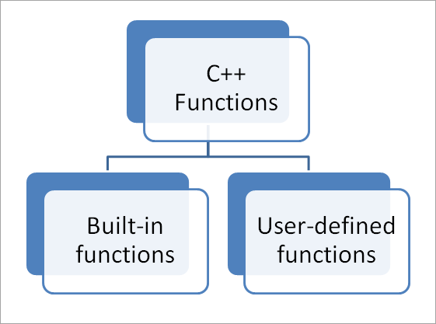
Function

Slide 17
Build In Function
#include <iostream>
#include <cmath>
using namespace std;
int main() {
double num, squareRoot;
cout << "Enter number: ";
cin >> num;
squareRoot = sqrt(num);
cout << "The square root of " << num << " is: " << squareRoot;
return 0;
}

Slide 18
User Defined Function
Steps to call function
Function prototype
Function call
Function definition

Slide 19
User Defined Function
Ways to invoke function
1.accept input and return output
int sum(int , int );
2. accept input and no output
void sum (int , int);
3. no input and return output
int sum();
4. no input but no output
void sum();

Slide 20
Practice Questions
Define a function that returns the product of two numbers entered by user.
Write a program to print the circumference and area of a circle of radius entered by user by defining your own function.
A person is elligible to vote if his/her age is greater than or equal to 18. Define a function to find out if he/she is elligible to vote.

Slide 21
Assignment For You
C++ Program to Check Armstrong Number using function . Function accepts a number and returns boolean value (int value =1 for true and 0 for false) True/False if armstrong number.
In the case of an Armstrong number of 3 digits, the sum of cubes of each digit is equal to the number itself. For example, 153 is an Armstrong number because
153 = 1*1*1 + 5*5*5 + 3*3*3

Slide 22

QNA Time
Any Questions??
Any Questions ??

Slide 23
Thank You!
See you guys in next class.

